Slide 1
Time series data analysis

Slide 2

Time Series Analysis
A time series is a sequence of numerical data points in successive order.
E.g. In investing, a time series tracks the movement of the chosen data points, such as a security’s price, over a specified period of time with data points recorded at regular intervals.
There is no minimum or maximum amount of time that must be included, allowing the data to be gathered in a way that provides the information being sought by the investor or analyst examining the activity.
According to classical time-series analysis an observed time series is the combination of some pattern and random variations.
The aim is to separate them from each other in order to
describe to historical pattern in the data,
prepare forecasts by projecting the revealed historical pattern future.
Notes:
Why is everyone talking about DATA SCIENCE? Last 5 years of trend on google search gives a clear picture. Industry/companies/organization/academic institutions are searching more and more of “data science” and “python”.
Am sure, all of you have heard about “data science” and/or “python/R/Spark/Hadoop/Kafka/.. Etc” and have some idea about these terms.
History of DS – it goes back to early 2000s .. 2004 when Google’s search engine was making a huge impact on the way we surfed the web. The reason for big data projects of Google is apparently linked to our increasing dependence on ‘data driven way of living’
When people talk of “data science” , they are in fact talking of companies like Google, Facebook, Twitter, Instagram etc.

Slide 3
Examples
Real gross national product in the United States, 1872-1985 (annual).
2. Rate of growth of real gross national product in the United States, 1873-1985 (annual).
3. Unemployment rate in the United States, 1873-1985 (annual).
4. Price level in the United States, 1870-1985 (annual).
5. Inflation rate in the United States, 1870-1985 (annual).
6. Logarithm of retail sales of men’s and boys’ clothing in the United States, 1967-1979
(quarterly).

Slide 4
Types of time series analysis
Time series analysis can be used to accomplish different goals:
Descriptive analysis determines what trends and patterns a time series has by plotting or using more complex techniques.
The most basic approach is to graph the time series and look at:
Overall trends (increase, decrease, etc.)
Cyclic patterns (seasonal effects, etc.)
Outliers – points of data that may be erroneous
Turning points – different trends within a data series

Slide 5
Types of time series analysis
Spectral analysis is carried out to describe how variation in a time series may be accounted for by cyclic components.
This may also be referred to as "Frequency Domain".
With this an estimate of the spectrum over a range of frequencies can be obtained and periodic components in a noisy environment can be separated out.
Example: What is seen in the ocean as random waves may actually be a number of different frequencies and amplitudes that are quite stable and predictable. Spectral analysis is used on the wave height vs. time to determine which frequencies are most responsible for the patterns that are there, but can’t be readily seen without analysis.

Slide 6
Types of time series analysis
Spectral analysis is carried out to describe how variation in a time series may be accounted for by cyclic components.
This may also be referred to as "Frequency Domain".
With this an estimate of the spectrum over a range of frequencies can be obtained and periodic components in a noisy environment can be separated out.
Example: What is seen in the ocean as random waves may actually be a number of different frequencies and amplitudes that are quite stable and predictable. Spectral analysis is used on the wave height vs. time to determine which frequencies are most responsible for the patterns that are there, but can’t be readily seen without analysis.

Slide 7
univariate time series
A univariate time series is a sequence of measurements of the same variable collected over time. Most often, the measurements are made at regular time intervals.
difference from standard linear regression
the data are not necessarily independent and not necessarily identically distributed.
the ordering matters.

Slide 8
Conceptual topics
Topics | Description
Stationarity | A stationary time series is one whose statistical properties such as mean, variance, autocorrelation, etc. are all constant over time.
Trends | shows the general tendency of the data to increase or decrease during a long period of time.
Seasonality | seasonality is the presence of variations that occur at specific regular intervals less than a year, such as weekly, monthly, or quarterly.
Cyclical movements | A cyclic pattern exists when data exhibit rises and falls that are not of fixed period.
Unexpected variations | These fluctuations are unforeseen, uncontrollable, unpredictable, and are erratic. These forces are earthquakes, wars, flood, famines, and any other disasters.
Traditional methods of time series analysis are concerned with decomposing of a series into a trend, a seasonal variation and other irregular fluctuations.

Slide 9
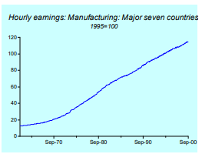
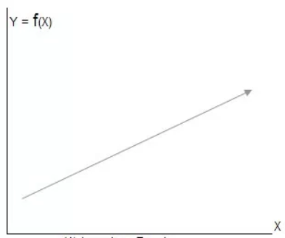
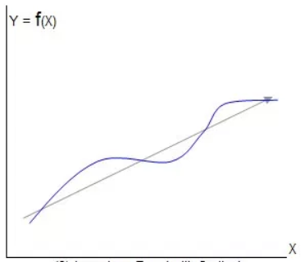
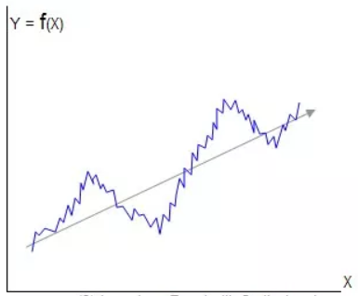
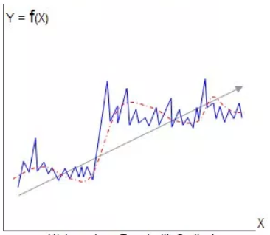
Trend
a general systematic linear or (most often) nonlinear component that changes over time and does not repeat
Secular Trend or Long Term Variation (can be linear, non-linear, i.e. exponential, quadratic
Long term trend
Long term trend with cyclical variations
Long term trend with cyclical and seasonal variations
Long term trend with cyclical, seasonal and random variations

Slide 10
Trends - types
2 general classes of trends:
Deterministic Trends: These are trends that consistently increase or decrease.
Stochastic Trends: These are trends that increase and decrease inconsistently.
In general, deterministic trends are easier to identify and remove
Another way to look at trends:-
Global Trends: These are trends that apply to the whole time series.
Local Trends: These are trends that apply to parts or subsequences of a time series.
Generally, global trends are easier to identify and address.
A time series with a trend is called non-stationary.

Slide 11
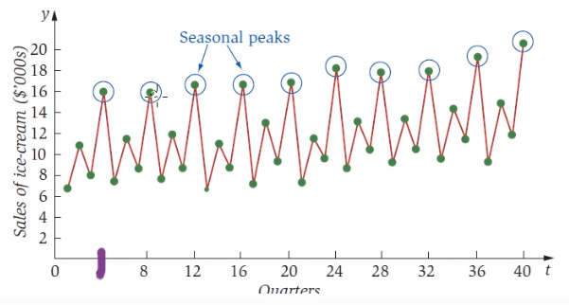
Seasonality
seasonality is the presence of variations that occur at specific regular intervals less than a year, such as weekly, monthly, or quarterly. (no longer than a year)
may be caused by various factors, such as weather, vacation, and holidays and consists of periodic, repetitive and generally regular and predictable patterns (peaks and troughs)
periodic time series - Seasonality is always of a fixed and known period.
Repetitive
Does not have to tie to seasons!
Seasonal
With positive secular trend

Slide 12
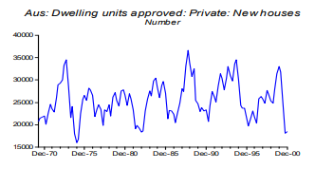
Cyclical movements
A cyclic pattern exists when data exhibit rises and falls that are not of fixed period.
unpredictable
The duration of these fluctuations is usually of at least 2 years.
Think of business cycles which usually last several years, but where the length of the current cycle is unknown beforehand.
no set amount of time between those fluctuations.

Slide 13
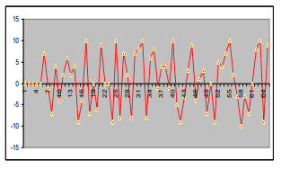
Unexpected variations
The random variations of the data comprise the deviations of the observed time series from the underlying pattern.

Slide 14
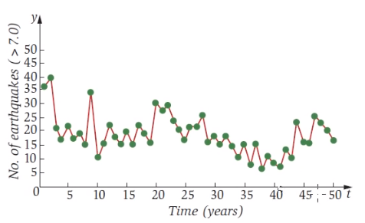
example
Aspect | comments
Seasonality | Peaks not regular periodicity
Trend | No apparent trend
Cyclic | Yes, as the peaks and troughs are irregular
Random

Slide 15
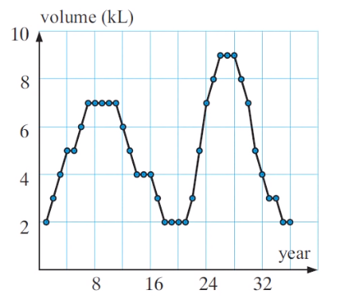
example
Aspect | comments
Seasonality | Peaks not regular periodicity
Trend | Slight positive secular trend
Cyclic | Yes, as the peaks and troughs are irregular
Random

Slide 16
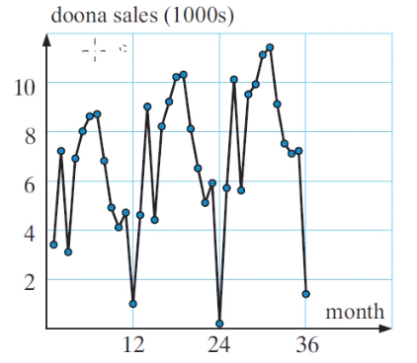
example
Aspect | comments
Seasonality | Yes, Peaks and troughs occur at regular periodicity
Trend | Slight positive/upward secular trend
Cyclic | No
Random | No

Slide 17
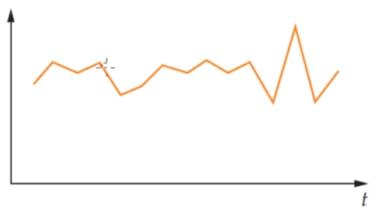
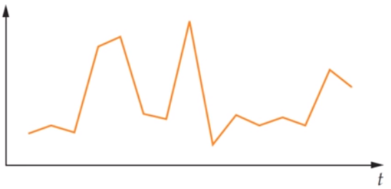
Example –
Aspect | comments
Seasonality | no
Trend | possibly
Cyclic | No
Random | Yes

Slide 18
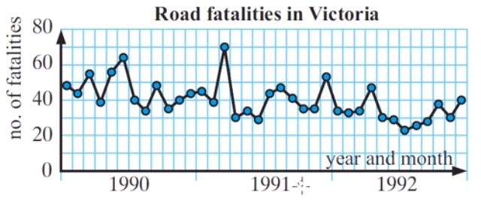
Example – random time series
Aspect | comments
Seasonality | No
Trend | Downward negative trend
Cyclic | No
Random | Yes

Slide 19
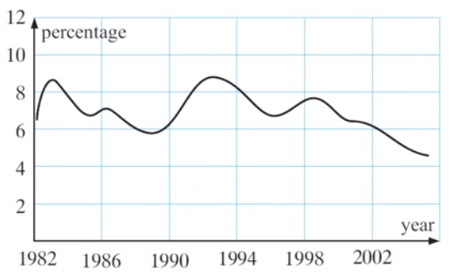
example
Aspect | comments
Seasonality | No
Trend | Slight Downward negative trend
Cyclic | Yes (peaks at irregular points)
Random | No

Slide 20
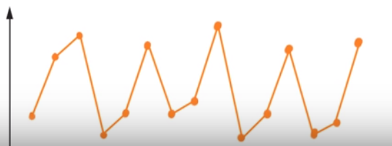
example
Aspect | comments
Seasonality | Yes
Trend | No trend
Cyclic | No
Random | No

Slide 21
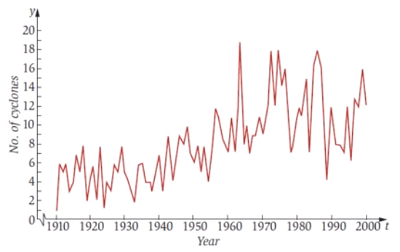
example
Aspect | comments
Seasonality | No
Trend | Upward secular trend
Cyclic | Yes (peaks at irregular points)
Random | No

Slide 22
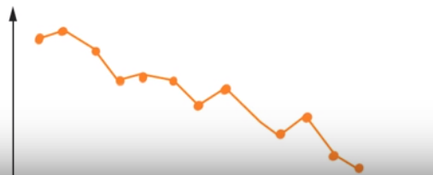
example
Aspect | comments
Seasonality | No
Trend | Downward secular trend
Cyclic | No
Random | Yes

Slide 23
example
Aspect | comments
Seasonality | No
Trend | Downward secular trend
Cyclic | No
Random | Yes

Slide 24
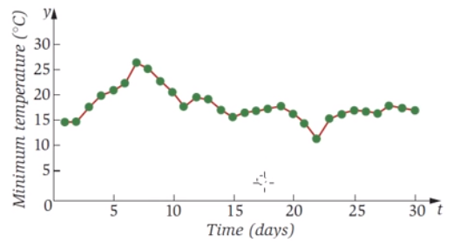
example
Aspect | comments
Seasonality | No
Trend | Downward secular trend
Cyclic | No
Random | Yes
Variation | Decreasing

Slide 25
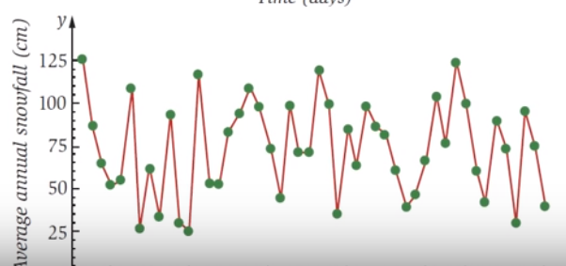

example
Aspect | comments
Seasonality | No
Trend | No trend
Cyclic | Yes (peaks and troughs occur at irregular points)
Random | Yes
Variation | About the same

Slide 26
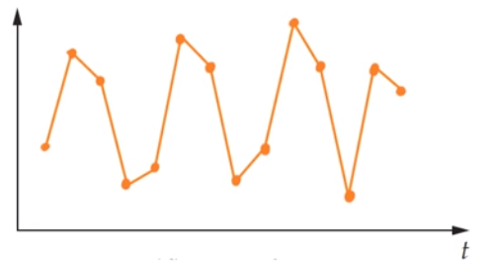
example
Aspect | comments
Seasonality | Yes (peaks and troughs occur at regular points)
Trend | Slight upward trend
Cyclic | No
Random | No
Variation | About the same

Slide 27
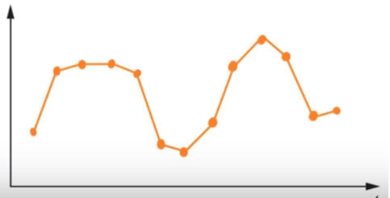
example
Aspect | comments
Seasonality | No (peaks and troughs occur at irregular points)
Trend | Slight upward trend
Cyclic | Yes
Random | No
Variation | About the same

Slide 28
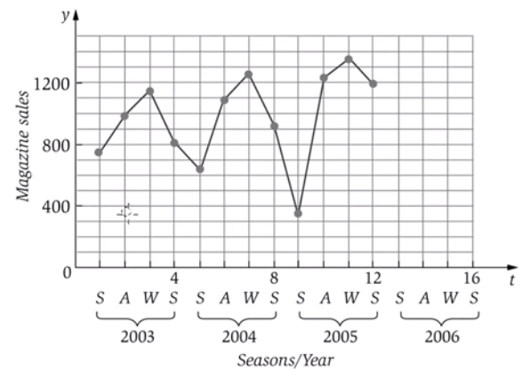
example
Aspect | comments
Seasonality | Yes (peaks and troughs occur at regular points)
Trend | Slight upward trend
Cyclic | No
Random | No
Variation | Increasing (cant say)

Slide 29
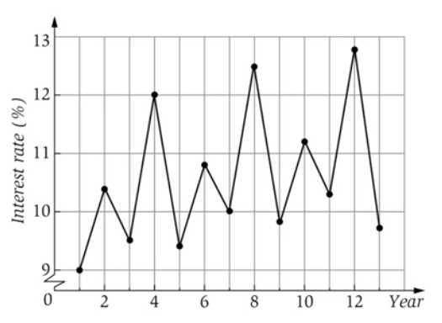
example
Aspect | comments
Seasonality | Yes (peaks and troughs occur at regular points)
Trend | upward trend
Cyclic | No
Random | No
Variation | About same

Slide 30
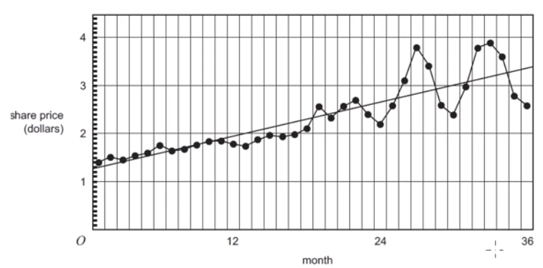
example
Aspect | comments
Seasonality | No
Trend | upward trend
Cyclic | No
Random | No
Variation | increasing
Which is true?
Share price shows no trend and no change in variability?
Share price shows no trend and increase in variability?
Share price shows upward trend with constant variability?
Share price shows upward trend with decreasing variability?
Share price shows upward trend with increasing variability?

Slide 31
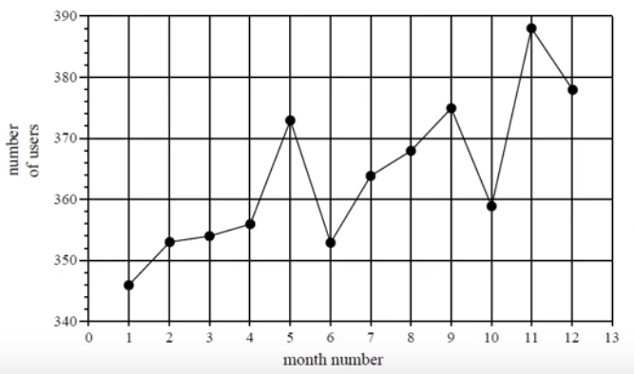
example
Aspect | comments
Seasonality | No
Trend | upward trend
Cyclic | No
Random | No
Variation | About the same
The time series plot has
No trend
No variability
Seasonality only
Increasing trend with seasonality
An increasing trend only

Slide 32
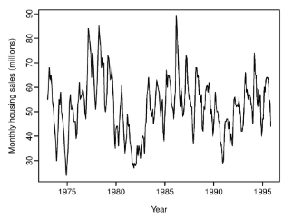
examples
Aspect | comments
Seasonality | Yes
Trend | Not much
Cyclic | No
Random | No
Variation | About the same
The monthly housing sales show strong seasonality within each year, as well as some strong cyclic behavior with period about 6–10 years.
There is no apparent trend in the data over this period.

Slide 33
White Noise
A time series is white noise if the variables are independent and identically distributed with a mean of zero.
same variance (sigma^2)
each value has a zero correlation with all other values in the series.
If a time series is white noise, it is a sequence of random numbers and cannot be predicted.
If the series of forecast errors are not white noise, it suggests improvements could be made to the predictive model.

Slide 34
Noise - Why Does it Matter?
2 main reasons:
Predictability: If your time series is white noise, then, by definition, it is random. We cannot reasonably model it and make predictions.
Model Diagnostics: The series of errors from a time series forecast model should ideally be white noise.

Slide 35
smoothing

Slide 36
What is & Why smoothing
Smoothing is a process of taking out the random fluctuations in the time series. Studying trend with fluctuations is erroneous
Generally speaking, the aim of smoothing is to remove “irregular” noise and cyclical components of the time series.
Aims to provide a more accurate prediction of the long term trend.
Some smoothing techniques do carry the cyclical information forward but others would remove them.
Methods to smooth
Using means
Using medians

Slide 37
Mean smoothing - odd
Year | Sales | 3-mean smoothed | 5-mean smoothed
2002 | 8
2003 | 21 | 14
2004 | 13 | 17 | 13.6
2005 | 17 | 13 | 17
2006 | 9 | 17 | 16.8
2007 | 25 | 18 | 19.6
2008 | 20 | 24 | 20
2009 | 27 | 22 | 22.4
2010 | 19 | 22.33333333 | 21
2011 | 21 | 19.33333333 | 20.4
2012 | 18 | 18.66666667 | 19.4
2013 | 17 | 19 | 19.2
2014 | 22 | 19 | 19.2
2015 | 18 | 20.33333333 | 19.4
2016 | 21 | 19.33333333 | 19
2017 | 19 | 18.33333333
2018 | 15
Note : be careful of over-smoothing

Slide 38
Mean smoothing - even
Year | Sales | 4-mean smoothed
2002 | 8
2003 | 21 | 14.75
2004 | 13 | 15 | 14.875
2005 | 17 | 16 | 15.5
2006 | 9 | 17.75 | 16.875
2007 | 25 | 20.25 | 19
2008 | 20 | 22.75 | 21.5
2009 | 27 | 21.75 | 22.25
2010 | 19 | 21.25 | 21.5
2011 | 21 | 18.75 | 20
2012 | 18 | 19.5 | 19.125
2013 | 17 | 18.75 | 19.125
2014 | 22 | 19.5 | 19.125
2015 | 18 | 20 | 19.75
2016 | 21 | 18.25 | 19.125
2017 | 19 | 13.75
2018 | 15
More smooth averaging, very obvious trend !!

Slide 39
Median smoothing - odd
Year | Sales | 3-median smoothed | 5-median smoothed
2002 | 8
2003 | 21 | 13
2004 | 13 | 17 | 13
2005 | 17 | 13 | 17
2006 | 9 | 17 | 17
2007 | 25 | 20 | 20
2008 | 20 | 25 | 20
2009 | 27 | 20 | 21
2010 | 19 | 21 | 20
2011 | 21 | 19 | 19
2012 | 18 | 18 | 19
2013 | 17 | 18 | 18
2014 | 22 | 18 | 18
2015 | 18 | 21 | 19
2016 | 21 | 19
2017 | 19 | 19
2018 | 15

Slide 40
Median smoothing - odd
Year | Sales | 4-median smoothed | centered
2002 | 8
2003 | 21 | 15
2004 | 13 | 15 | 15
2005 | 17 | 15 | 15
2006 | 9 | 18.5 | 16.75
2007 | 25 | 22.5 | 20.5
2008 | 20 | 22.5 | 22.5
2009 | 27 | 20.5 | 21.5
2010 | 19 | 20 | 20.25
2011 | 21 | 18.5 | 19.25
2012 | 18 | 19.5 | 19
2013 | 17 | 18 | 18.75
2014 | 22 | 19.5 | 18.75
2015 | 18 | 20 | 19.75
2016 | 21 | 18.5 | 19.25
2017 | 19 | 19
2018 | 15

Slide 41
When to use mean & median smoothing?
Mean smoothing | Median smoothing
Means are affected by outliers | Medians are not affected by outliers, generally

Slide 42
Basic Time series structures
Additive Model | Multiplicative Model
y_{t}= T_{t}+ S_{t}+ C_{t}+ R_{t} | y_{t}= T_{t} x S_{t} x C_{t} x R_{t}
The additive model is useful when the seasonal variation is relatively constant over time. | The multiplicative model is useful when the seasonal variation increases over time.
different components affect the time series additively
E.g. for monthly data, an additive model assumes that the difference between the January and July values is approximately the same each year. In other words, the amplitude of the seasonal effect is the same each year.

Slide 43
methods for identifying the pattern:
SMOOTHING TECHNIQUES | Decomposition
used to remove, or at least reduce, the random fluctuations in a time series so as to more clearly expose the existence of the other components. | y_{t}= T_{t} x S_{t} x C_{t} x R_{t}
2 types of smoothing techniques Moving averages Exponential smoothing | The multiplicative model is useful when the seasonal variation increases over time.
Moving averages for a given time period is the (arithmetic) average of the values in that time period and those close to it. | exponentially smoothed value for a given time period is the weighted average of all the available values up to that period.

Slide 44
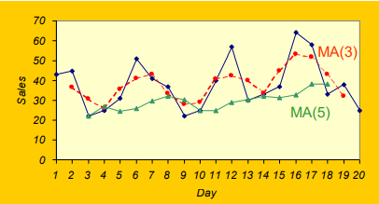
Smoothing techniques – moving average
Day | Sales | 3-day moving sum | 3-day moving average
1 | 43
2 | 45 | 110 | 36.67
3 | 22 | 92 | 30.67
4 | 25 | 78 | 26.00
5 | 31 | 107 | 35.67
6 | 51
No MA value for the first (neither for the last) day.
The longer the moving average period
the stronger the smoothing effect,
the shorter the smoothed series
When the moving average period is large, the following are removed
the random variations,
the seasonal and
cyclical variations
only the long-term trend can be revealed.
Refer to python code ML-TIME-SERIES-05-smoothing

Slide 45
different classical time series forecasting methods
Autoregression (AR)
Moving Average (MA)
Autoregressive Moving Average (ARMA)
Autoregressive Integrated Moving Average (ARIMA)
Seasonal Autoregressive Integrated Moving-Average (SARIMA)
Seasonal Autoregressive Integrated Moving-Average with Exogenous Regressors (SARIMAX)
Vector Autoregression (VAR)
Vector Autoregression Moving-Average (VARMA)
Vector Autoregression Moving-Average with Exogenous Regressors (VARMAX)
Simple Exponential Smoothing (SES)
Holt Winter’s Exponential Smoothing (HWES)

Slide 46
Types of Models
There are 2 basic types of “time domain” models.
Models that relate the present value of a series to past values and past prediction errors - these are called ARIMA models (for Autoregressive Integrated Moving Average).
Ordinary regression models that use time indices as x-variables. These can be helpful for an initial description of the data and form the basis of several simple forecasting methods.

Slide 47
Important Characteristics to Consider
Is there a trend, i.e. the measurements tend to increase (or decrease) over time?
Is there seasonality, meaning that there is a regularly repeating pattern of highs and lows related to calendar time such as seasons, quarters, months, days of the week, and so on?
Are their outliers? In regression, outliers are far away from the line. With time series data, the outliers are far away from the other data.
Is there a long-run cycle or period unrelated to seasonality factors?
Is there constant variance over time, or is the variance non-constant?
Are there any abrupt changes to either the level of the series or the variance?

Slide 48
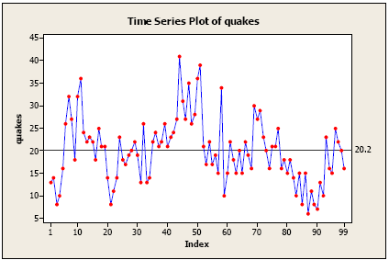
Example
time series plot of the annual number of earthquakes in the world with seismic magnitude over 7.0, for last 99 years.
No consistent trend (upward or downward) over the entire time span.
The horizontal line drawn at quakes = 20.2 indicates the mean of the series.
Notice that the series tends to stay on the same side of the mean (above or below) for a while and then wanders to the other side.
Almost by definition, there is no seasonality as the data are annual data.
There are no obvious outliers.
It’s difficult to judge whether the variance is constant or not.

Slide 49
Times series - models

Slide 50
Autoregressive (AR)
Autoregressive models and processes are stochastic calculations in which future values are estimated based on a weighted sum of past values.
model of order p
Autoregressive models and processes operate under the premise that past values have an effect on current values
Regression models forecast a variable using a linear combination of predictors, whereas autoregressive models use a combination of past values of the variable.
not applicable on non-stationary series.

Slide 51
Autoregressive (AR)
An AR(1) autoregressive process is the first order process, meaning that the current value is based on the immediately preceding value,
An AR(2) process has the current value based on the previous two values.
An AR(0) process is used for white noise and has no dependence between the terms.
Coefficients
many different ways to calculate the coefficients used in these calculations, including the ordinary least squares or method of movements.
One drawback to autoregressive models is that past prices won't always be the best predictor of future movements, if the underlying fundamentals of a company have changed.

Slide 52
Moving Average - MA
A moving average (MA) is a widely used indicator in technical analysis
model of order q
not applicable on non-stationary series.
A moving average model is different from calculating the moving average of the time series.
Helps smooth out price action by filtering out the “noise” from random short-term price fluctuations.
It is a trend-following, or lagging, indicator because it is based on past prices.
The two basic and commonly used moving averages
simple moving average (SMA), which is the simple average of a security over a defined number of time periods,
exponential moving average (EMA), which gives greater weight to more recent prices.

Slide 53
Moving Average - MA – what it tells
MA lag current price action because they are based on past prices;
The longer the time period for the moving average, the greater the lag.
200-day MA will have a much greater degree of lag than a 20-day MA
The length of the moving average to use depends on the trading objectives,
with shorter moving averages used for short-term trading and longer-term moving averages more suited for long-term investors.
The 50-day and 200-day MAs are widely followed by investors and traders, with breaks above and below this moving average considered to be important trading signals.
A rising moving average indicates that the security is in an uptrend, while a declining moving average indicates that it is in a downtrend.

Slide 54
Moving Average - MA
The most common applications of moving averages are to
identify the trend direction, and
to determine support and resistance levels.

Slide 55
AutoREgressive Moving Average – (arma)
model of order p, q

Slide 56
arima
generalization of an autoregressive moving average (ARMA) model
An autoregressive integrated moving average, or ARIMA, is a statistical analysis model that uses time series data to either
better understand the data set or
to predict future trends.
An autoregressive integrated moving average model is a form of regression analysis that gauges the strength of one dependent variable relative to other changing variables. The model's goal is to predict future securities or financial market moves by examining the differences between values in the series instead of through actual values.

Slide 57
BREAKING DOWN - ARIMA
components
Autoregression (AR) refers to a model that shows a changing variable that regresses on its own lagged, or prior, values.
Integrated (I) represents the differencing of raw observations to allow for the time series to become stationary, i.e., data values are replaced by the difference between the data values and the previous values.
Moving average (MA) incorporates the dependency between an observation and a residual error from a moving average model applied to lagged observations.

Slide 58
ARIMA - notations
ARIMA models are typically expressed like “ARIMA(p, d, q)”,
ARIMA - standard notation
p, d, and q
where integer values substitute for the parameters to indicate the type of ARIMA model used.
The parameters can be defined as:
p: the number of lag observations in the model; also known as the lag order. This captures the “autoregressive” nature of ARIMA.
d: the number of times that the raw observations are differenced; also known as the degree of differencing. This captures the “integrated” nature of ARIMA
q: the size of the moving average window; also known as the order of the moving average.

Slide 59
Using TS models
Criteria | Choice | Comments
data does not have a trend or a seasonal component | Moving Average Single Exp Smoothing
data has a trend but does not have a seasonal component | Trend Analysis Double Exp Smoothing | Trend Analysis fits a single equation to the data, which works well when the trend follows a consistent shape without shifts or reversals. Double Exponential Smoothing uses a dynamic trend component that works well when the data have cyclical movements, shifts in the trend, or even reversals in the trend.
data have a seasonal component | Decomposition Winters’ Method | Use Winters' Method when you want to use your time series model to generate forecasts. Usually, you should not use Decomposition to generate forecasts, but it can be useful to examine the components of the time series. For example, you could use Decomposition to communicate time series concepts to management.

Slide 60
questions

Slide 61
question
1) Which of the following is an example of time series problem?
1. Estimating number of hotel rooms booking in next 6 months. 2. Estimating the total sales in next 3 years of an insurance company. 3. Estimating the number of calls for the next one week.
A) Only 3 B) 1 and 2 C) 2 and 3 D) 1 and 3 E) 1,2 and 3
Solution: (E)

Slide 62
question
2) Which of the following is not an example of a time series model?
A) Naive approach B) Exponential smoothing C) Moving Average D) None of the above
Solution: (D)

Slide 63
3) Which of the following can’t be a component for a time series plot?
A) Seasonality
B) Trend
C) Cyclical
D) Noise
E) None of the above
Solution: (E)

